Slide 1

Iron Mountain Incorporated Pricing Strategy
Team 11
Yuying He, Tianyao Liu, Handi Wang, Zhuoyi Ying, Ruixuan Zhao

Slide 2
01
Analysis Methodology and Framework
02
Price Variance in Different Situations
Agenda
03
Pricing Strategy Recommendation
04
Potential Impact of Recommendation

Slide 3
01
Analysis Methodology and Framework
Pricing Strategy for LA-acquired
Take LA as a reference
Generalize into 3 service types.(service/storage/transport)
Reweighted average price (based on invoice quantity)
Explore price difference in different bill code type and es/non-es market respectively.
1
3
Price Variance in difference situations:
By Location & Business Type
Market Name & Bill code Type
By Company characteristics
Same market for same service type (New Jersey’s storage).
Potential Impacts of Recommendations:
Advantages
Disadvantages
Limitation due to lack of information
2
Notes:
:

Slide 4
02
Price Variances in Different Situations
Is there a variance that customers are paying by location or something else?
By Location | By Company Characters
Different unit rates are existing in different markets: Service: SIOUX FALLS, KINGSTON, RMS, MISSOUIA Storage :ROANOKE, SYRACUSE, WEST VIRGINIA Transportation: WINNIPEG Different location have different business type: some locations cover both paper storage and media storage while others only cover one of them | Customers pay differently even in same market for same service type (eg. New Jersey & storage). Influencing factors: Company scope Database size Security level requirement Storage medium Data usage frequency

Slide 5
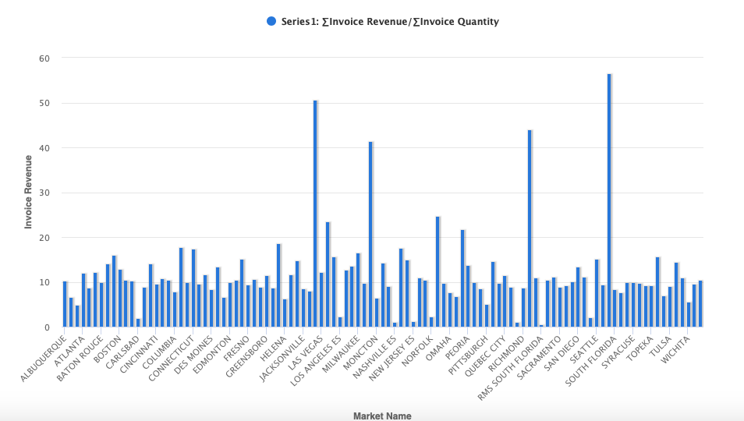
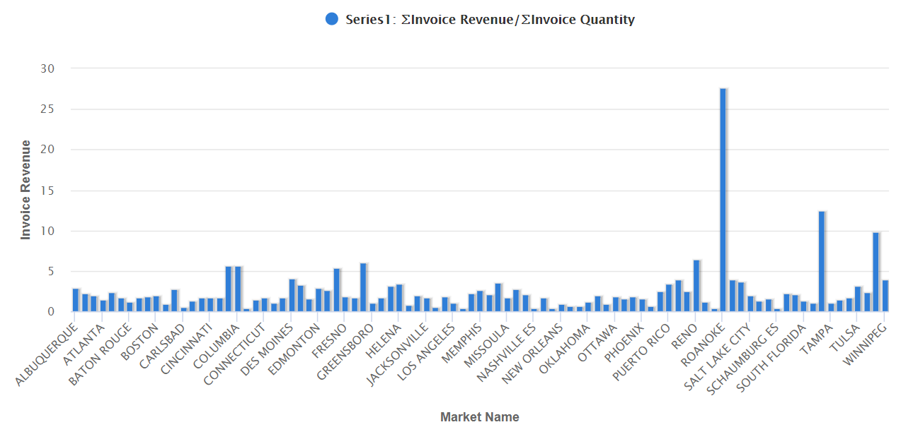
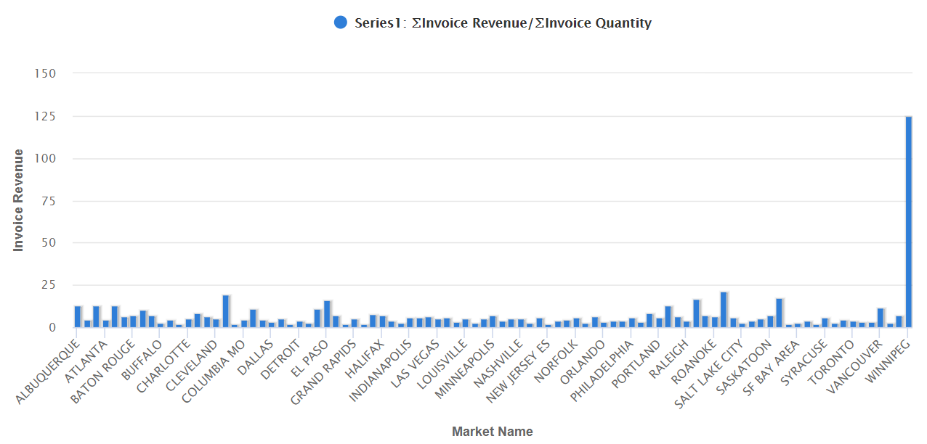
02
Price Variances in Different Situations
——Different Unit Price by Location
Service
There exists different price patterns across market on three bill code types including service, storage and transportation.
Customers in SIOUX FALLS pay highest in service type; customers in RANOKE invest the most in storage type while WINNPEG market generate highest price of the transportation type
KINGSTON
SIOUX FALLS
MISSOUIA
RMS
Storage
Transportation
RAONOKE
WINNPEG
WEST
VIRGINIA
SYRACUSE

Slide 6
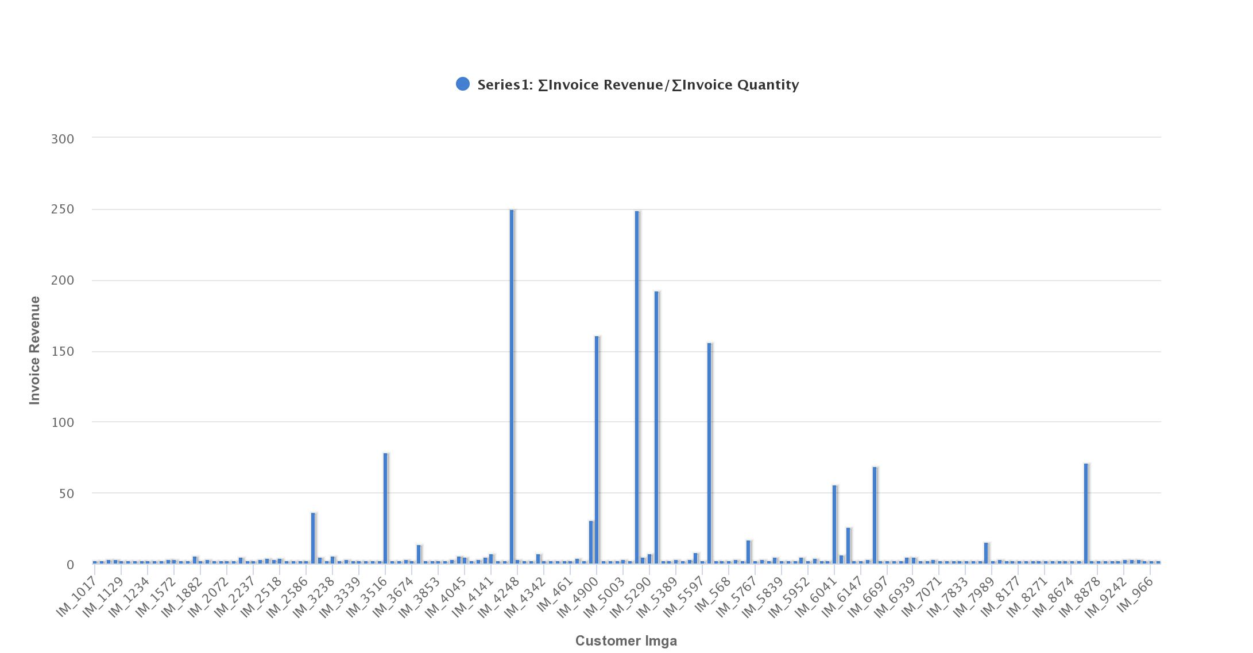
02
Price Variances in Different Situations
——Different Unit Price by Company
Customers pay differently even in same market (e.g.New Jersey Market) for same service type (storage).
The price is different because of customers’ multiple database sizes, security level requirements, company scope, storage media, as well as data usage frequency, etc.

Slide 7
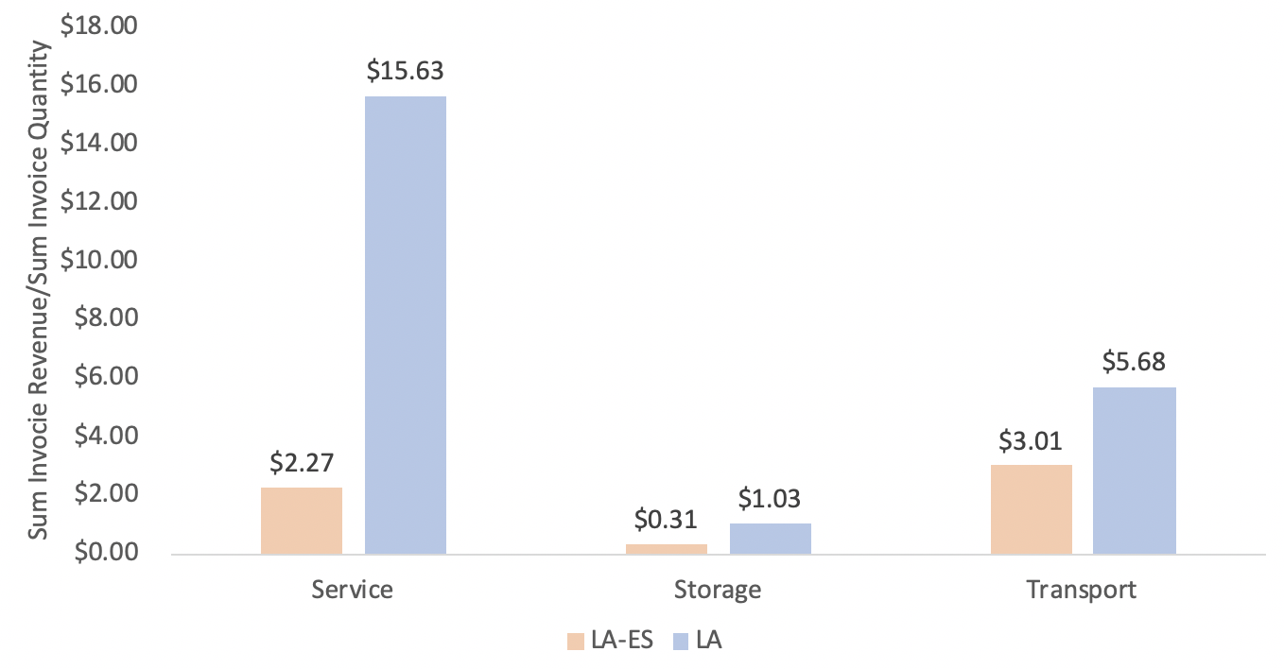
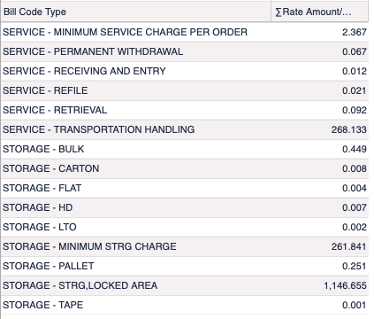
03
Pricing Strategy Recommendation
Are we having higher or lower price in LA-acquired market segment?
LA-ES unit price VS. LA unit price
Methodology of unit price for different BillCode Type both in LA-ES and LA:
Sum(Invoice Revenue)/Sum(Invoice Quantity)
Average price of service in LA -acquired market in average ($2.16) is lower that in LA-ES market($2.27) and LA market($15.63).
We generalize service -transportation to transportation bill code type, which average price($272.45) is higher than the corresponding LA-ES transportation average price($3.01) and LA transportation average price($5.68).
Average price of storage bill code type in LA-acquired market($160.65) is higher than that in LA-ES market($0.31) and LA market($1.03), which is affected by extreme values.

Slide 8
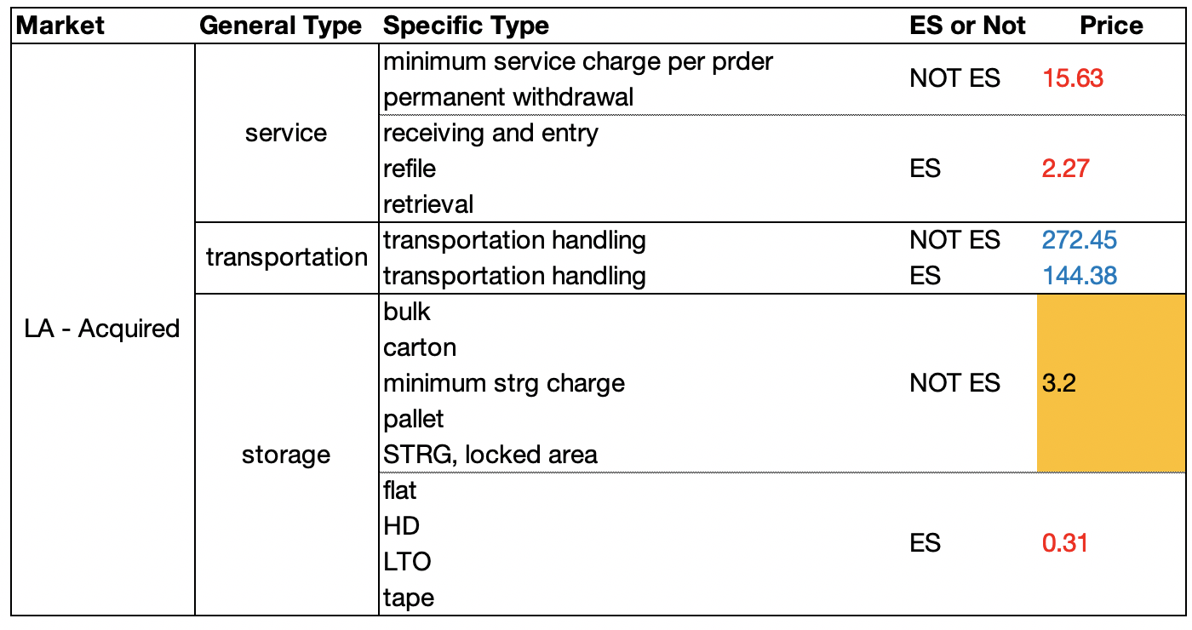
03
Pricing Strategy Recommendation
LA-ES unit price VS. LA unit price
Recommended Price List for Iron Mountain
We choose LA market’s rates as the reference price. The price recommendations are based on LA price, reweighted by invoice quantity. We keep original price which is higher than the price calculated based on the algorism, while raise the lower original price to the recommendation level.
*red: use LA original price
blue: use LA - Acquired original price
orange highlight: Reweighted recommendation level

Slide 9
03
Pricing Strategy Recommendation
——Influence of Size of Accounts on Pricing Strategy
Percentile | 0% | 50% | 90% | 95% | 99% | 100%
Account no. | 1 | 1 | 7 | 13 | 44 | 30385
As indicated in the second point, company size (evaluated by the number of child accounts under each customer Imga) should be considered.
We counted the unique value of child accounts under each Imga, also tooks their invoice revenue into consideration to calculated percentiles of the distribution to determine the relative size of acquired companies’ accounts.
According to the key points of the distribution table, we defined three account size:
Small: have 1 to 13 child accounts (0%~95%)
Medium: have 14 to 44 child accounts (95%~99%)
Large: have at least 45 child accounts (top1%)
Price discrimination could be implemented across different customer account size because of their different volume of information storage. Iron Mountain should impose a premium price on medium and large accounts who contains massive data compared to small accounts.

Slide 10

04
Potential Impacts of Recommendations
Advantages:
Disadvantages:
Less price fluctuation made pricing strategy get uniform return from each sales, which assured with certain profits.
Fixed price for each category doesn't allow flexible adjustments, which means cost bias is higher than expected .
Conducive to the establishment of a globally unified corporate image and product image, bettering brand positioning.
Fixed price may let us lose part of our customers because of the higher price we charge.
Fixed price is conducive to company's price management and marketing management, avoiding occurrence of parallel imports.
Our pricing recommendation on Transport will not be that precise due to lack of more information about the content of Transportation handling service.

Slide 11
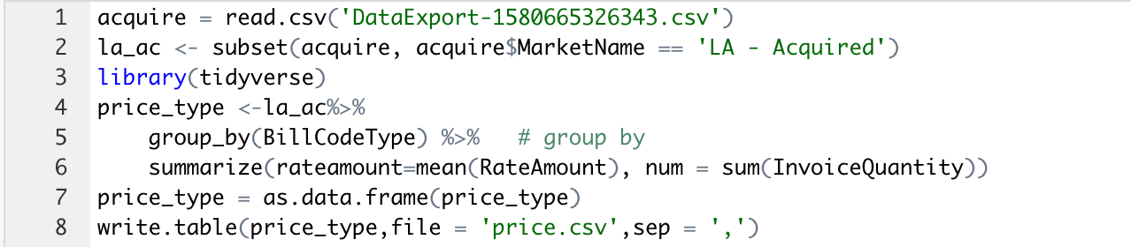
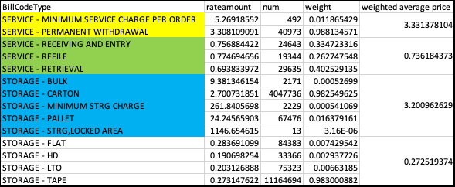
Appendix: Reweighted price

Slide 12
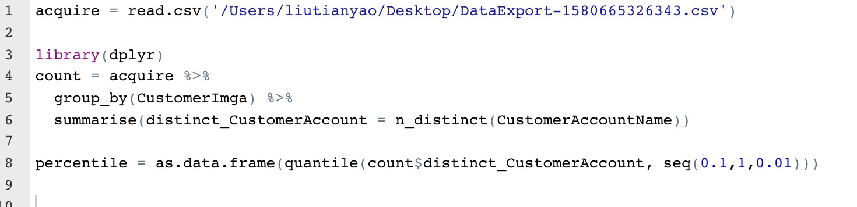
Appendix: Calculate the Distribution of Number of Child Accounts

Slide 13
Appendix: Limitations
The limitation of trasnportation mainly for below reasons:
1. The distribution of price in LA acquired is unbalanced especially in last 10 percent.
2. Compared with distribution in LA and LA-ES, which most price distribute around 0-50, the distribution in LA acquired is different, which means service transpotation handling may be different than 'transportation.

Slide 14
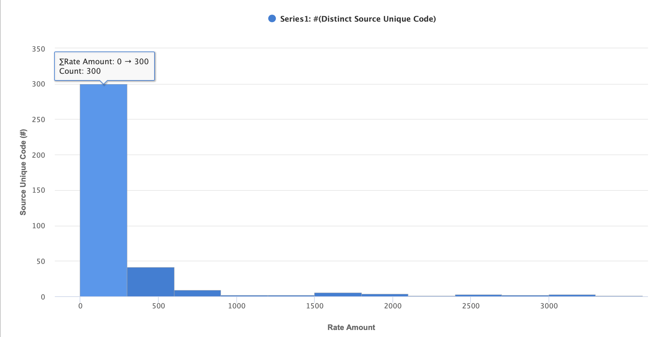
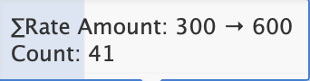
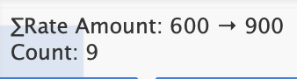
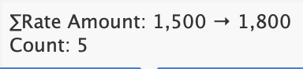
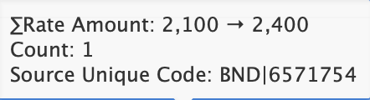
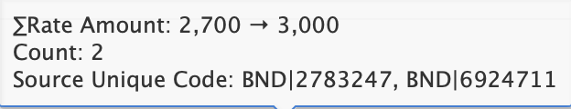
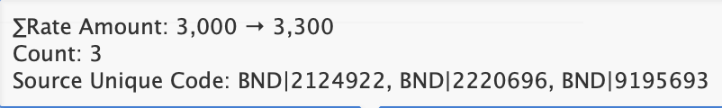
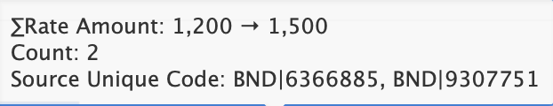
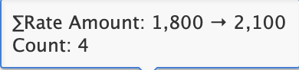
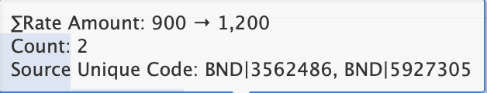
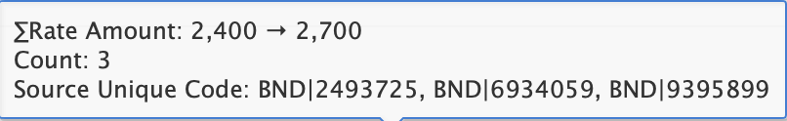
Appendix: the Distribution of rate amount of transportation handling in LA-acquired market

Slide 15
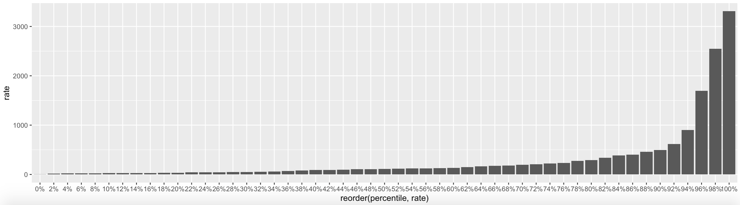
Appendix: the percentile distribution of rate amount of transportation handling in LA-acquired market

Slide 16
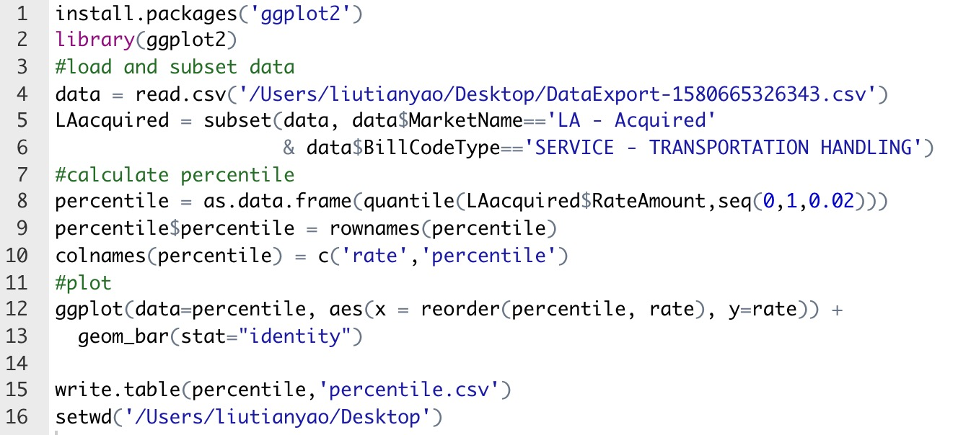
Appendix: the percentile distribution of rate amount of transportation handling in LA-acquired market(R-code)

Slide 17
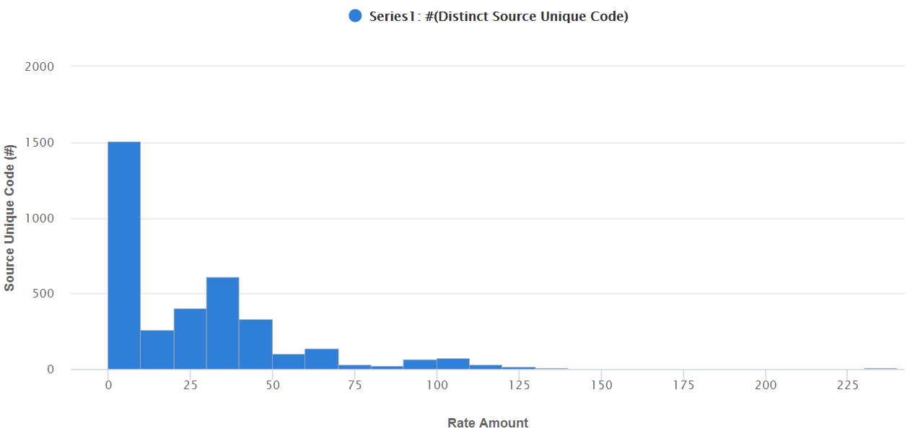
Appendix: the Distribution of rate amount of transportation handling in LA-ES market

Slide 18
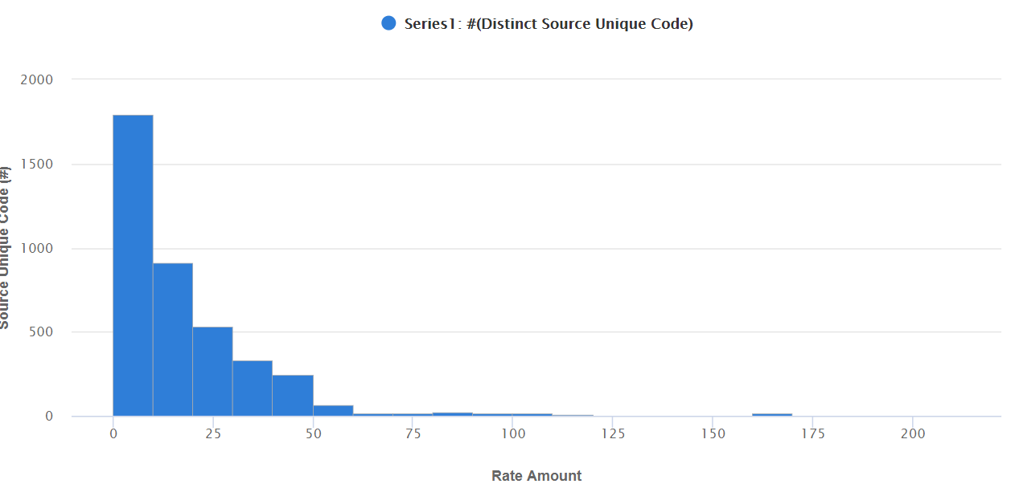
Appendix: the Distribution of rate amount of transportation handling in LA market

